Slide 1
February 7, 2021
The Church of Thessalonica
Acts 17:1-9 (Part 1)

Slide 2
Acts 17:1-5
1 Now when they had traveled through Amphipolis and Apollonia, they came to Thessalonica, where there was a synagogue of the Jews. 2 And according to Paul's custom, he went to them, and for three Sabbaths reasoned with them from the Scriptures, 3 explaining and giving evidence that the Christ had to suffer and rise again from the dead, and saying, "This Jesus whom I am proclaiming to you is the Christ." 4 And some of them were persuaded and joined Paul and Silas, along with a large number of the God-fearing Greeks and a number of the leading women. 5 But the Jews, becoming jealous and taking along some wicked men from the market place, formed a mob and set the city in an uproar; and attacking the house of Jason, they were seeking to bring them out to the people.

Slide 3
Acts 17:6-9
6 When they did not find them, they began dragging Jason and some brethren before the city authorities, shouting, "These men who have upset the world have come here also; 7 and Jason has welcomed them, and they all act contrary to the decrees of Caesar, saying that there is another king, Jesus." 8 They stirred up the crowd and the city authorities who heard these things. 9 And when they had received a pledge from Jason and the others, they released them.

Slide 4
Outline of Acts 17:1-9
The arriving to Thessalonica (17:1a)
The activity in Thessalonica (17:1b-4)
The antagonism at Thessalonica (17:5-9)

Slide 5
The Arriving to Thessalonica (17:1a)
Now when they had traveled through Amphipolis and Apollonia, they came to Thessalonica…

Slide 6
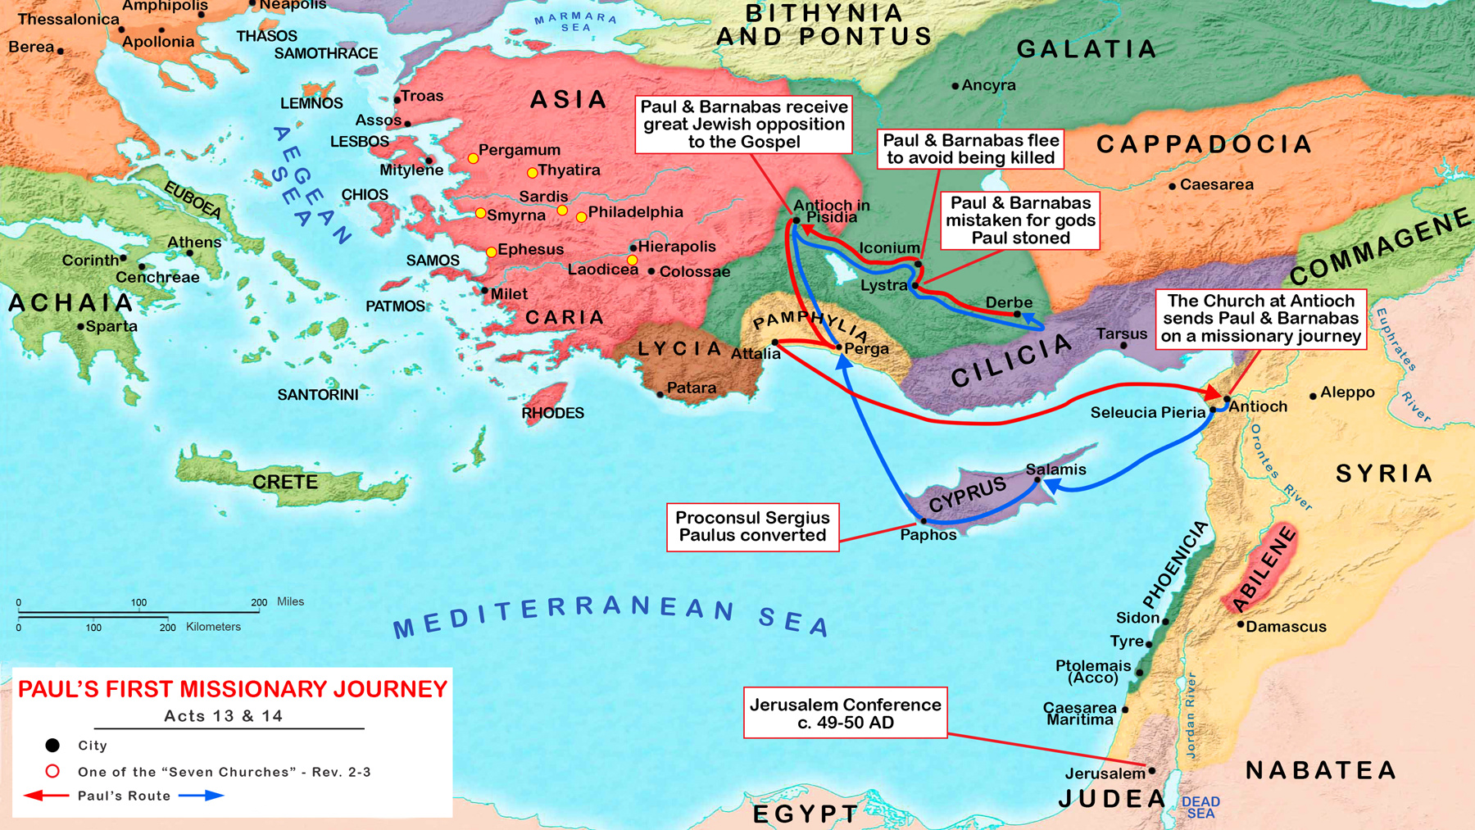
Acts 17:6-9

Slide 7
Acts 14:21-23
21 After they had preached the gospel to that city and had made many disciples, they returned to Lystra and to Iconium and to Antioch, 22 strengthening the souls of the disciples, encouraging them to continue in the faith, and saying, "Through many tribulations we must enter the kingdom of God." 23 When they had appointed elders for them in every church, having prayed with fasting, they commended them to the Lord in whom they had believed.

Slide 8
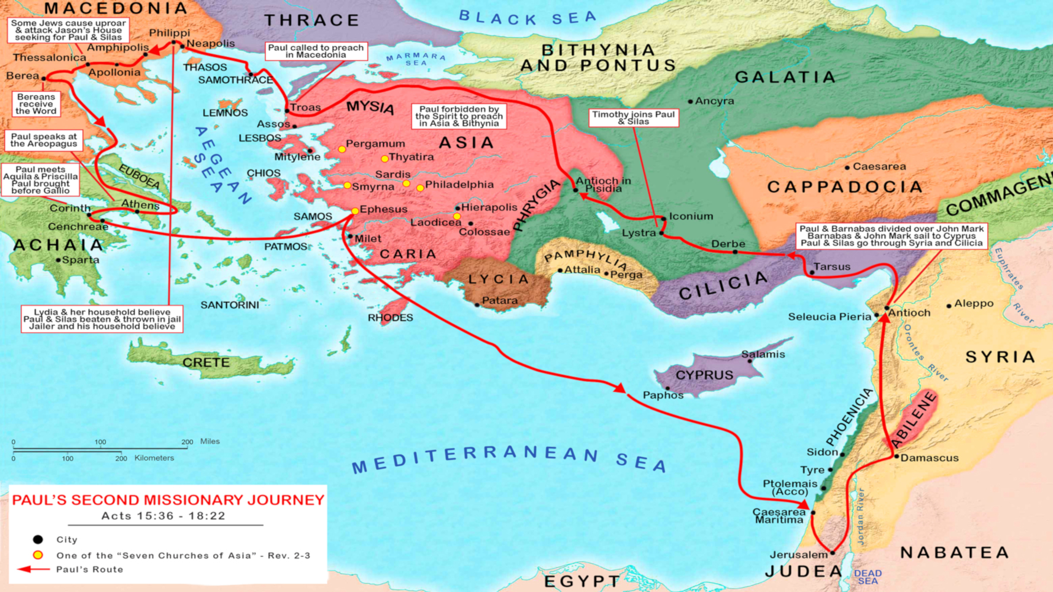
Acts 17:6-9

Slide 9
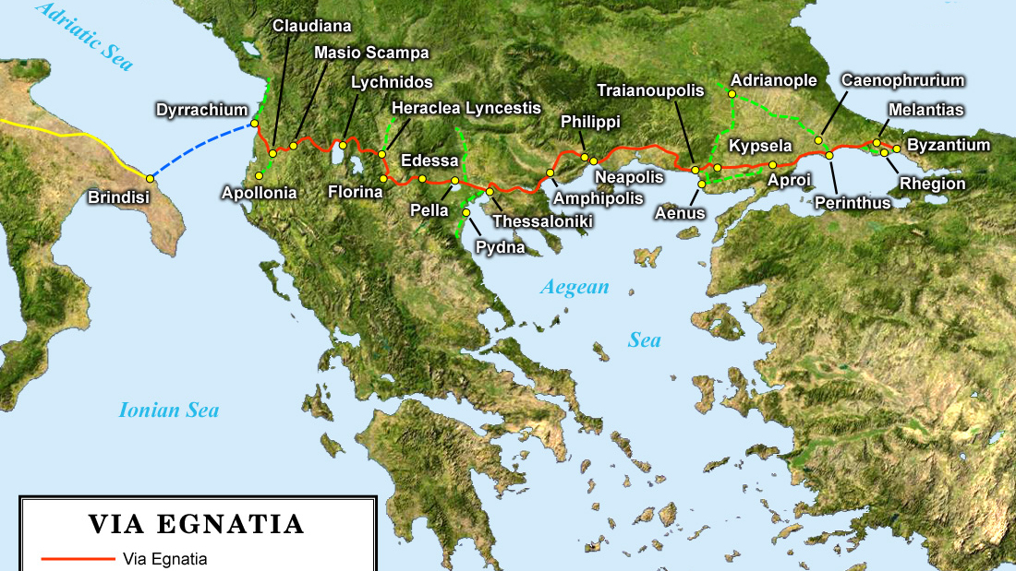
Acts 17:6-9

Slide 10
Paul’s Pattern
He went to the synagogue to preach the gospel.
He turned to the Gentiles to preach the gospel, and
He faced persecution.

Slide 11
The Activity in Thessalonica (17:1b-4)
Now when they had traveled through Amphipolis and Apollonia, they came to Thessalonica, where there was a synagogue of the Jews. 2 And according to Paul's custom, he went to them, and for three Sabbaths reasoned with them from the Scriptures, 3 explaining and giving evidence that the Christ had to suffer and rise again from the dead, and saying, "This Jesus whom I am proclaiming to you is the Christ." 4 And some of them were persuaded and joined Paul and Silas, along with a large number of the God-fearing Greeks and a number of the leading women.
Paul’s Practice (Acts 17:1-2)

Slide 12
Romans 1:16
For I am not ashamed of the gospel, for it is the power of God for salvation to everyone who believes, to the Jew first and also to the Greek.

Slide 13
Matthew 10:5-6
“Do not go in the way of the Gentiles, and do not enter any city of the Samaritans; but rather go to the lost sheep of the house of Israel.”

Slide 14
Acts 13:43, 48-49
“43…many of the Jews and of the God-fearing proselytes followed Paul and Barnabas… 48 When the Gentile heard this, they began rejoicing and glorifying the word of the Lord. 49 And the word of the Lord was being spread through the whole region.”

Slide 15
Romans 15:20
And thus I aspired to preach the gospel, not where Christ was already named, so that I would not build on another man's foundation…

Slide 16
The Activity in Thessalonica (17:1b-4)
Now when they had traveled through Amphipolis and Apollonia, they came to Thessalonica, where there was a synagogue of the Jews. 2 And according to Paul's custom, he went to them, and for three Sabbaths reasoned with them from the Scriptures, 3 explaining and giving evidence that the Christ had to suffer and rise again from the dead, and saying, "This Jesus whom I am proclaiming to you is the Christ." 4 And some of them were persuaded and joined Paul and Silas, along with a large number of the God-fearing Greeks and a number of the leading women.
Paul’s Practice (Acts 17:1-2)
Paul’s Process (Acts 17:3a)
“explaining” – “opening” (Luke 2:23; Acts 7:56; Luke 24:32, 45)
“giving evidence” – “placing before” (Mark 6:41; 2 Timothy 2:2; Matthew 13:24, 31)

Slide 17
The Activity in Thessalonica (17:1b-4)
Now when they had traveled through Amphipolis and Apollonia, they came to Thessalonica, where there was a synagogue of the Jews. 2 And according to Paul's custom, he went to them, and for three Sabbaths reasoned with them from the Scriptures, 3 explaining and giving evidence that the Christ had to suffer and rise again from the dead, and saying, "This Jesus whom I am proclaiming to you is the Christ." 4 And some of them were persuaded and joined Paul and Silas, along with a large number of the God-fearing Greeks and a number of the leading women.
Paul’s Practice (Acts 17:1-2)
Paul’s Process (Acts 17:3a)
Paul’s Proclamation (Acts 17:3b)

Slide 18
Ephesians 3:4-5
“4 By referring to this, when you read you can understand my insight into the mystery of Christ, 5 which in other generations was not made known to the sons of men, as it has now been revealed to His holy apostles and prophets in the Spirit…”

Slide 19
Acts 9:22
“Saul [Paul] kept increasing in strength and confounding the Jews who lived at Damascus by proving that this Jesus is the Messiah.”

Slide 20
The Activity in Thessalonica (17:1b-4)
Now when they had traveled through Amphipolis and Apollonia, they came to Thessalonica, where there was a synagogue of the Jews. 2 And according to Paul's custom, he went to them, and for three Sabbaths reasoned with them from the Scriptures, 3 explaining and giving evidence that the Christ had to suffer and rise again from the dead, and saying, "This Jesus whom I am proclaiming to you is the Christ." 4 And some of them were persuaded and joined Paul and Silas, along with a large number of the God-fearing Greeks and a number of the leading women.
Paul’s Practice (Acts 17:1-2)
Paul’s Process (Acts 17:3a)
Paul’s Proclamation (Acts 17:3b)
Those who Paul Persuaded (Acts 17:4)

Slide 21
1 Thessalonians 4:1, 10 “excel still more”
1 Finally then, brethren, we request and exhort you in the Lord Jesus, that as you received from us instruction as to how you ought to walk and please God (just as you actually do walk), that you excel still more.
9 Now as to the love of the brethren, you have no need for anyone to write to you, for you yourselves are taught by God to love one another; 10 for indeed you do practice it toward all the brethren who are in all Macedonia. But we urge you, brethren, to excel still more…

Slide 22
February 7, 2021
The Church of Thessalonica
Acts 17:1-9 (Part 1)

